Slide 1


REALESTATE PREDICTOR: AI-DRIVEN REAL-TIME PROPERTY VALUATION
VALLURU MOHAMMAD RASHEED
--20BIT0216
GUIDE NAME: GUNDALA SWATHI MAM

Slide 2
Abstract
The "Real-estate Predictor: AI-Driven Real-Time Property Valuation" project uses advanced machine learning techniques to modernize property valuation practices. It collects and evaluates data on property attributes, fine-tunes models, and integrates fairness-aware algorithms. The project aims to revolutionize real estate decision-making by providing actionable insights and fostering trust in the valuation process through a user-friendly web application.

Slide 3

Problem definition
Traditional approaches are recognized as having limits in keeping up with the dynamic and fast-paced nature of the real estate business.
The difficulties connected with producing accurate and fast property values using traditional methods are noted as a major issue to be addressed.
Processing huge information and extracting useful insights from different property attributes are recognized as challenges that require novel solutions.
Recognizing the complexity associated with regional differences in property markets is critical, emphasizing the need for adaptation and customization in valuation methods.

Slide 4
Literature review
S.No | Title and year | Algorithm Used | Main Focus | Limitations
1 | Value Prediction of Real Estate Using Machine Learning (2023) | Linear regression, Lasso, decision tree | This paper predicts house prices based on variables like area, location, bedrooms, and bathrooms, aiming to assist researchers in creating accurate models for finding dream houses. | Decision trees can overfit when deep or improperly pruned, capturing training data noise as a pattern, leading to poor generalization to unseen data.
2 | An Innovative Method to Predict Real Estate Prices using Convolutional Block Attention Module (2023) | Convolutional Block Attention Module | This study aims to develop a method for accurately forecasting real estate prices using machine learning models and transaction data. It uses preprocessing, feature selection, and model training, with the CBAM model for training. The proposed technique outperforms GRU and LSTM models. | CBAM implementation increases training complexity due to additional parameters, data and computational resources needed for attention mechanisms, and may consume more memory.
3 | Real Estate Prediction System Using ML (2023) | NLP & CNN | A machine learning model was created in this paper to predict the likelihood of a price increase for real estate properties. The model utilizes features such as property area, age of construction, available rooms, direction of the property, and more. By incorporating these features, the system achieves over 80% accuracy in predicting price increases | Poor textual data quality or noise can hinder NLP models from extracting meaningful features, while CNNs are designed for spatial hierarchies, but may not be relevant in real estate data.

Slide 5
Literature review
S.No | Title and year | Algorithm Used | Main Focus | Limitations
4 | Productivity assessment of the real estate industry in China: a DEA-Malmquist index (2023) | DEA model | The paper analyzes China's real estate industry using DEA-Malmquist index and tobit regression analysis. It reveals high-quality development depends on innovation and government policies. Policy suggestions include future development orientation, policy formulation, and real estate management. Limitations include limited database consideration. | DEA-Malmquist may face challenges in handling dynamic and rapidly changing environments. Real estate markets are influenced by dynamic factors, and the static nature of DEA might not capture these changes effectively.
5 | A multi-level modelling approach for predicting real-estate dynamics (2023) | Elastic Net & Lasso regressor | The paper introduces a multilevel forecasting model for predicting key real estate market variables, including house sales, average price, and HPI. It improves forecasting capabilities and is applicable to any city in the USA. The model also highlights the relationship between socioeconomic variables and the real estate market. | Elastic Net is computationally more intensive than simpler regularization techniques, especially for large datasets and high-dimensional feature spaces, and the optimization problem can be complex and time-consuming.
6 | Training a Neural Network to Predict House Rents Using Artificial Intelligence and Deep Learning (2023) | Deep Learning | The paper explores the use of neural networks to predict housing rents, highlighting the potential of AI in the real estate industry, based on features like square footage, floor, restaurant availability, and pets. | especially deep learning models, often require large amounts of data for training to generalize well. If your real estate dataset is limited, the model may struggle to capture the complexity of property valuation patterns.

Slide 6

Literature review
1. An Innovative Method to Predict Real Estate Prices using Convolutional Block Attention Module
It was published on 2023 and written by G N P V Babu, Dr. Vijayalakshmi N.S, Sameer Yadav, Dr. E. Manigandan, Chahat Gulati, Dr Aditya Kumar Singh Pundir.
They have used Convolutional Block Attention Module to develop their model.
It gives accuracy around 85%
This study intends to develop a novel method to accurately forecast real estate prices using machine learning models and actual transaction data.
Implementing CBAM adds complexity to the training process. The attention mechanisms require additional parameters, and training a model with attention mechanisms may require more data and computational resources.
It uses more memory

Slide 7
Literature review
2. Predict Condominium Prices in Bangkok Based on Ensemble Learning Algorithm with various factors
It was published in 2023 and written by T. Anchaleechamaikorn, T. Lamjiak, T. Thongpe, L. Therapeutant and J. Polvichai.
They have used Random Forest Regressor & Gradient Boosting Regressor.
This study proposes an AI-based system to evaluate condominium prices faster, more cost-effectively, and without human bias. The methodology includes web scraping and machine learning techniques to accurately predict condominium prices.
The dataset is obtained from a popular Thai property website, covering appraisal years from 2008 to 2019.
Training a large number of decision trees in parallel can be computationally expensive and memory-intensive, especially with large datasets. This can limit their applicability in resource-constrained environments.

Slide 8

Literature review
3. Real Estate Prediction System Using ML
It was published in 2023 and written by Abhinav Wandhe, Lakshya Sehgal, Hardik Sumra, Aryaman Choudhary, Mrunalee Dhone
They have used Natural Language Processing (NLP) and Convolutional Neural Networks (CNN).
A machine learning model was created in this paper to predict the likelihood of a price increase for real estate properties. The model utilizes features such as property area, age of construction, available rooms, direction of the property, and more. By incorporating these features, the system achieves over 80% accuracy in predicting price increases. This model is useful for investors and home buyers in making profitable purchase decisions.
If the quality of the textual data, such as property descriptions or reviews, is poor or contains a lot of noise, NLP models might struggle to extract meaningful features and patterns.
CNNs are designed for tasks where spatial hierarchies are important, like image recognition. In real estate data, the spatial invariance captured by CNNs might not be as relevant, as the data might not have the same grid-like structure as images.

Slide 9
Literature review
4. Using Machine Learning to Predict Housing Prices
It was published in 2023 and written by H. Prakash, K. Kanaujia and S. Juneja.
They have used Artificial Neural Network & Support Vector Regression.
Real estate is a volatile investment vehicle that impacts the global economy. A literature review was conducted to identify the most efficient models for predicting property prices. Machine learning techniques like ANN & SVM are effective in predicting accurate prices. Location and structural characteristics are important factors in predicting house prices. This study helps identify key attributes for determining property prices and the best machine learning models for research in this field.
ANNs, especially deep learning models, often require large amounts of data for training to generalize well. If your real estate dataset is limited, the model may struggle to capture the complexity of property valuation patterns.

Slide 10
Literature review
5. Productivity assessment of the real estate industry in China: a DEA-Malmquist index
It was published in 2023 and written by Xiao-xiao Liu, Hui-hui Liu, Guo-liang Yang and Jiao-feng Pan.
They have used Data Envelopment Analysis-Malmquist index.
This study explores the significance of the real estate industry for China's economy by investigating total factor productivity (TFP) of 30 provinces from 2007 to 2016. Results show that technological innovation by real estate enterprises and targeted policies by provincial government are crucial for high-quality development. The industry has a positive correlation with China's economic growth, but a negative correlation with the development of other industries..
DEA-Malmquist may face challenges in handling dynamic and rapidly changing environments. Real estate markets are influenced by dynamic factors, and the static nature of DEA might not capture these changes effectively.

Slide 11

Objectives
The major goal is to create a powerful AI-powered real-time property appraisal system, demonstrating a commitment to technological innovation.
The project's goal is to improve accuracy by implementing a variety of advanced regression approaches, with an emphasis on precision and dependability in valuation outputs.
Create a web application that can easily be understandable to end users.
Adding transparency and explainability elements displays a commitment to ensure that people understand and trust the AI model's decision-making process.

Slide 12
Scope
The project's goal is to establish a real-time property valuation system that can be tailored to different regions and property kinds. It brings together several data sources to offer a thorough picture of property assessments. The system is intended to be user-friendly, with capabilities that allow homeowners and real estate professionals to access and analyze property values by reviewing graphs and web application and collaboration with real estate specialists ensures that industry expertise is included. Scalability is also an important consideration. The initiative intends to provide a new standard for real estate appraisal procedures..

Slide 13
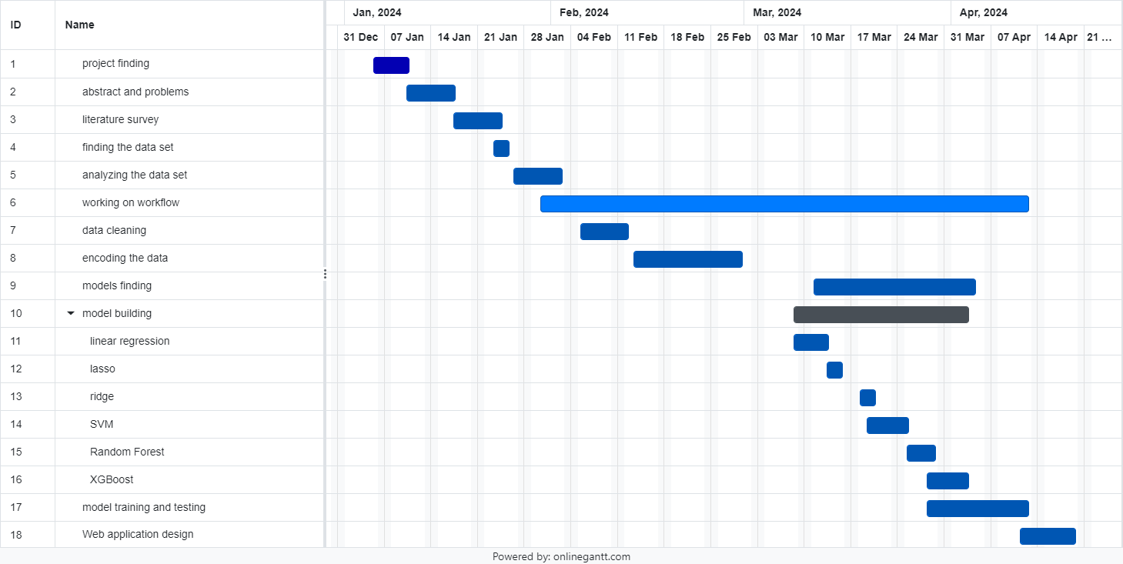

Gantt Chart

Slide 14

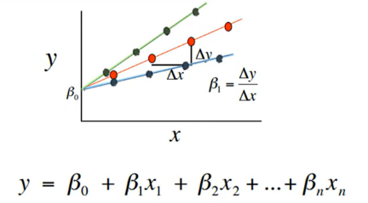
Proposed methodlogy
I have used 6 various ml algorithms to check the best algorithm with respective to accuracy
Linear regression
Lasso regression
Ridge regression
Support vector machine
Random forest
XGBoost

Slide 15


1. Linear regression
This model builds links between the many variables being studied. Correlation coefficients or regression equations can be used to determine the correlation between variables. There are models that can identify the most important aspects for understanding the dependent variable. Multiple regression is used to collect data on both independent and dependent factors to anticipate certain prices. Multiple linear regression determines the link between dependent and independent variables.

Slide 16
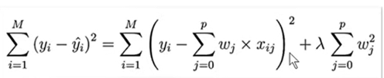
2. Ridge Regression
This model builds if linear regression model becomes overfitted then we use this to increase the efficiency of the model. By using linear regression, we will find cost function it means we will subtract the actual value with the predicted value and squares the outcome. Main aim to build this model is to get the value as zero So, to get this we will add the multiple of alpha and square of the slope. This will increase the efficiency.

Slide 17
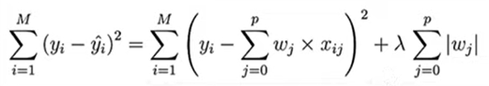

3. Lasso Regression
This model builds if linear regression model becomes overfitted then we use this to increase the efficiency of the model. By using linear regression, we will find cost function it means we will subtract the actual value with the predicted value and squares the outcome. Main aim to build this model is to get the value as zero So, to get this we will add the multiple of alpha and magnitude of the slope. This will increase the efficiency.

Slide 18
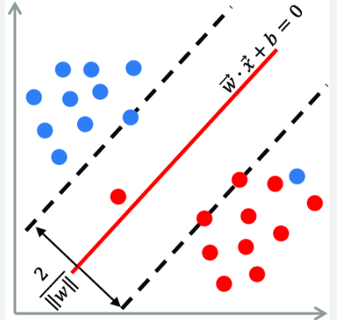
4. Linear support vector Regression
In SVM regression, the aim is to create a function f(x) that predicts the target variable y based on input characteristics. The hyperplane in SVM regression is defined as f(x)=⟨w,x⟩+b, where w represents the weight vector, x is the input feature vector, and b is the bias factor. The hyperplane aims to suit the data points as closely as possible while maximizing the margin.

Slide 19

5. Random forest
Random Forest regression is an ensemble learning approach that integrates the predictions of numerous decision trees to get a more accurate and stable result. During training, several decision trees are created from random subsets of the training data and features. Each tree is trained individually, and the final prediction is calculated by averaging the predictions of all individual trees (for regression tasks). This ensemble technique reduces overfitting and improves generalization performance. Furthermore, Random Forests incorporates unpredictability into the feature selection process, increasing the model's resilience and lowering the danger of overfitting.

Slide 20

6. XGBoost
Extreme Gradient Boosting (XGBoost) is a well-known and strong machine learning technique that excels in regression and classification problems. It is part of the gradient boosting method family, which iteratively creates an ensemble of weak learners to minimize a given loss function. XGBoost begins by fitting an initial decision tree to the data and then adds additional trees in a sequential order to rectify mistakes caused by earlier models. Each new tree is trained using the residuals.

Slide 21
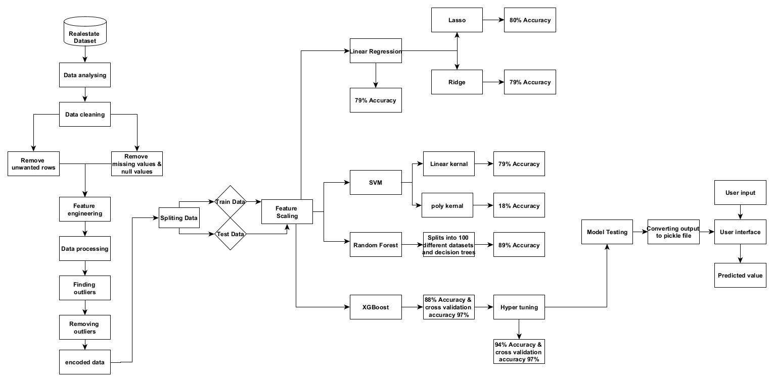
System Architecture

Slide 22

The architecture provides the complete process of the model from beginning to end. We start with the data collection and cleaning the data and removes the unwanted data from the data set. Now we need to preprocess the data. After that we need to find any outliers present in the data and remove it after completing all the transformations now, we need to train the model and test that model and after that we need to deploy it flask.

Slide 23

Module Description:
Data analysis: In this stage we need to check the data first and get detailed information about the data whether it is useful or not.
Data cleaning: In this stage we need to search for null values if u find any null values in any column with minimum % then drop that row from the table and if u got so many null values in the column, then u need to drop that column, if u don’t drop that column it leads to failure of our model. In my data society has 41.3% missing value so I have dropped that column

Slide 24
Module Description:
Data preprocessing: In this stage we need to convert the data into integer type by that we can easily train and test our regression model.
Feature scaling: we need to do feature scaling for the data because the values of the features is in different range. If it has different range, then it might have a chance of to reduce the working efficiency

Slide 25
Module Description:
Model training: In this stage I have used 6 models to compare the models which gives best accuracy. First, I have used linear regression in that I got an accuracy of 79% and rsme value of round 65-70% so it is overfitting. Then I used lasso, ridge and SVM too they also not gave much convenient outcome, so I used random forest and XGBoost models then I got some good accuracy. I used the XGBoost model to train and test the model.
Deployment: In this stage I build a front-end model to showcase the output with the help of flask to combine the web application and the model.

Slide 26

Libraries
Flask: A micro web framework for Python and used for building web applications, APIs, and web services
Pandas: A powerful data manipulation and analysis library used for data manipulation, including reading, and writing data from various file formats, data cleaning, reshaping, merging, slicing, and aggregating data.
Scikit-learn: A machine learning library for Python employed for implementing machine learning algorithms, including data preprocessing, model selection, training, evaluation, and deployment.

Slide 27

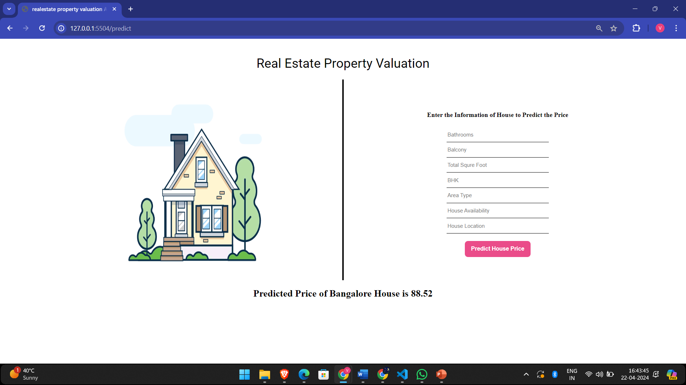
Libraries
Matplotlib: A plotting library for creating static, interactive, and animated visualizations in Python Utilized for creating static, interactive, and animated visualizations such as line plots, scatter plots, histograms, bar charts, pie charts, etc., to explore and communicate insights from data.
Seaborn: A data visualization library based on Matplotlib, providing a high-level interface for drawing attractive and informative statistical graphics.

Slide 28
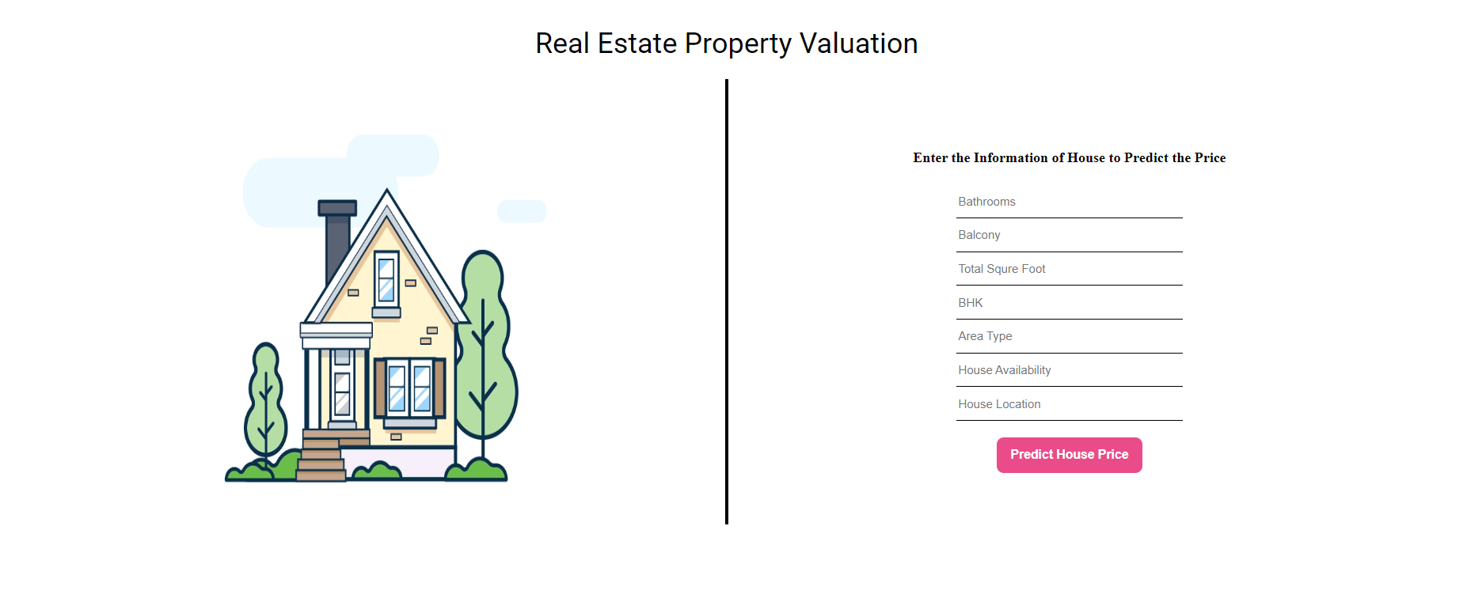
Web Application

Slide 29


Slide 30


Slide 31

8.CONCLUSION AND FUTURE SCOPE
This project is a huge step forward in the field of real estate assessment, providing a powerful combination of accuracy.
The project has effectively solved significant issues inherent in traditional valuation methodologies by integrating cutting-edge AI and machine learning technology, as well as a dedication to innovation and honesty.
The anticipated price is based on dataset information, including area, location, number of bedrooms, and bathrooms.
In future work we need to incorporate the environmental factors such as proximity to residential areas, parking lots, and marketplaces, we can significantly enhance the accuracy of the mode

Slide 32
Thank You

